Slide 1
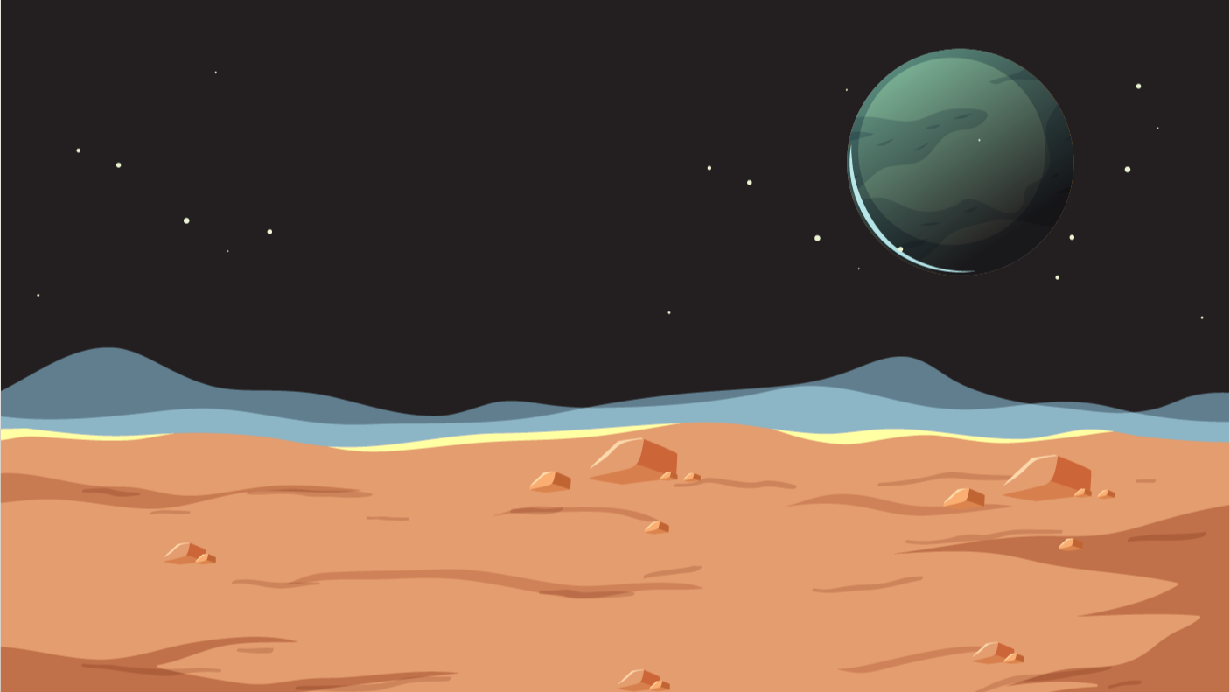

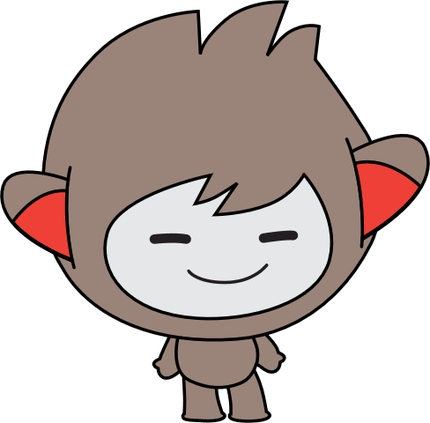


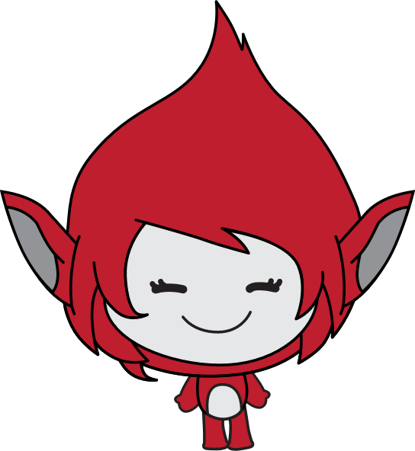
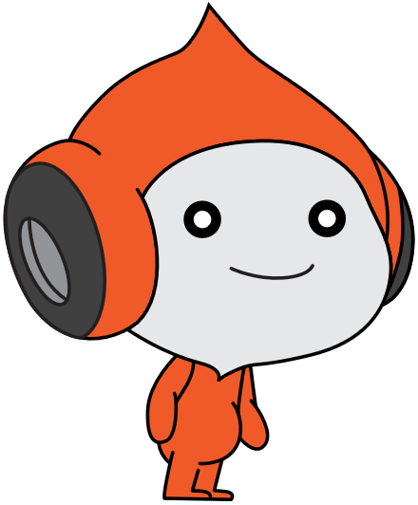
Lesson 1:
space talk

Slide 2
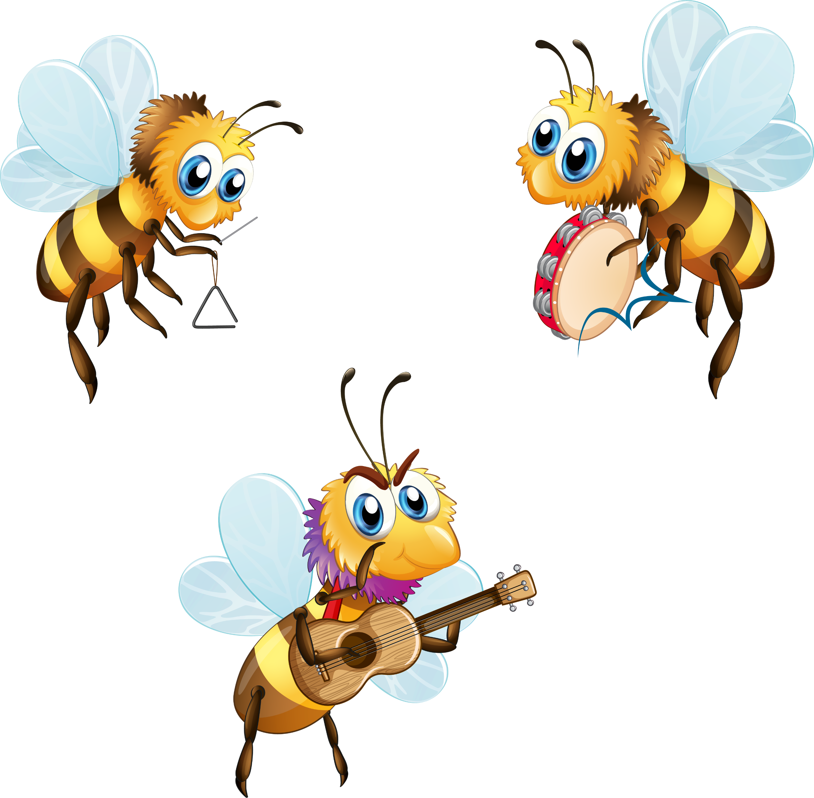
Bee dance…

Slide 3
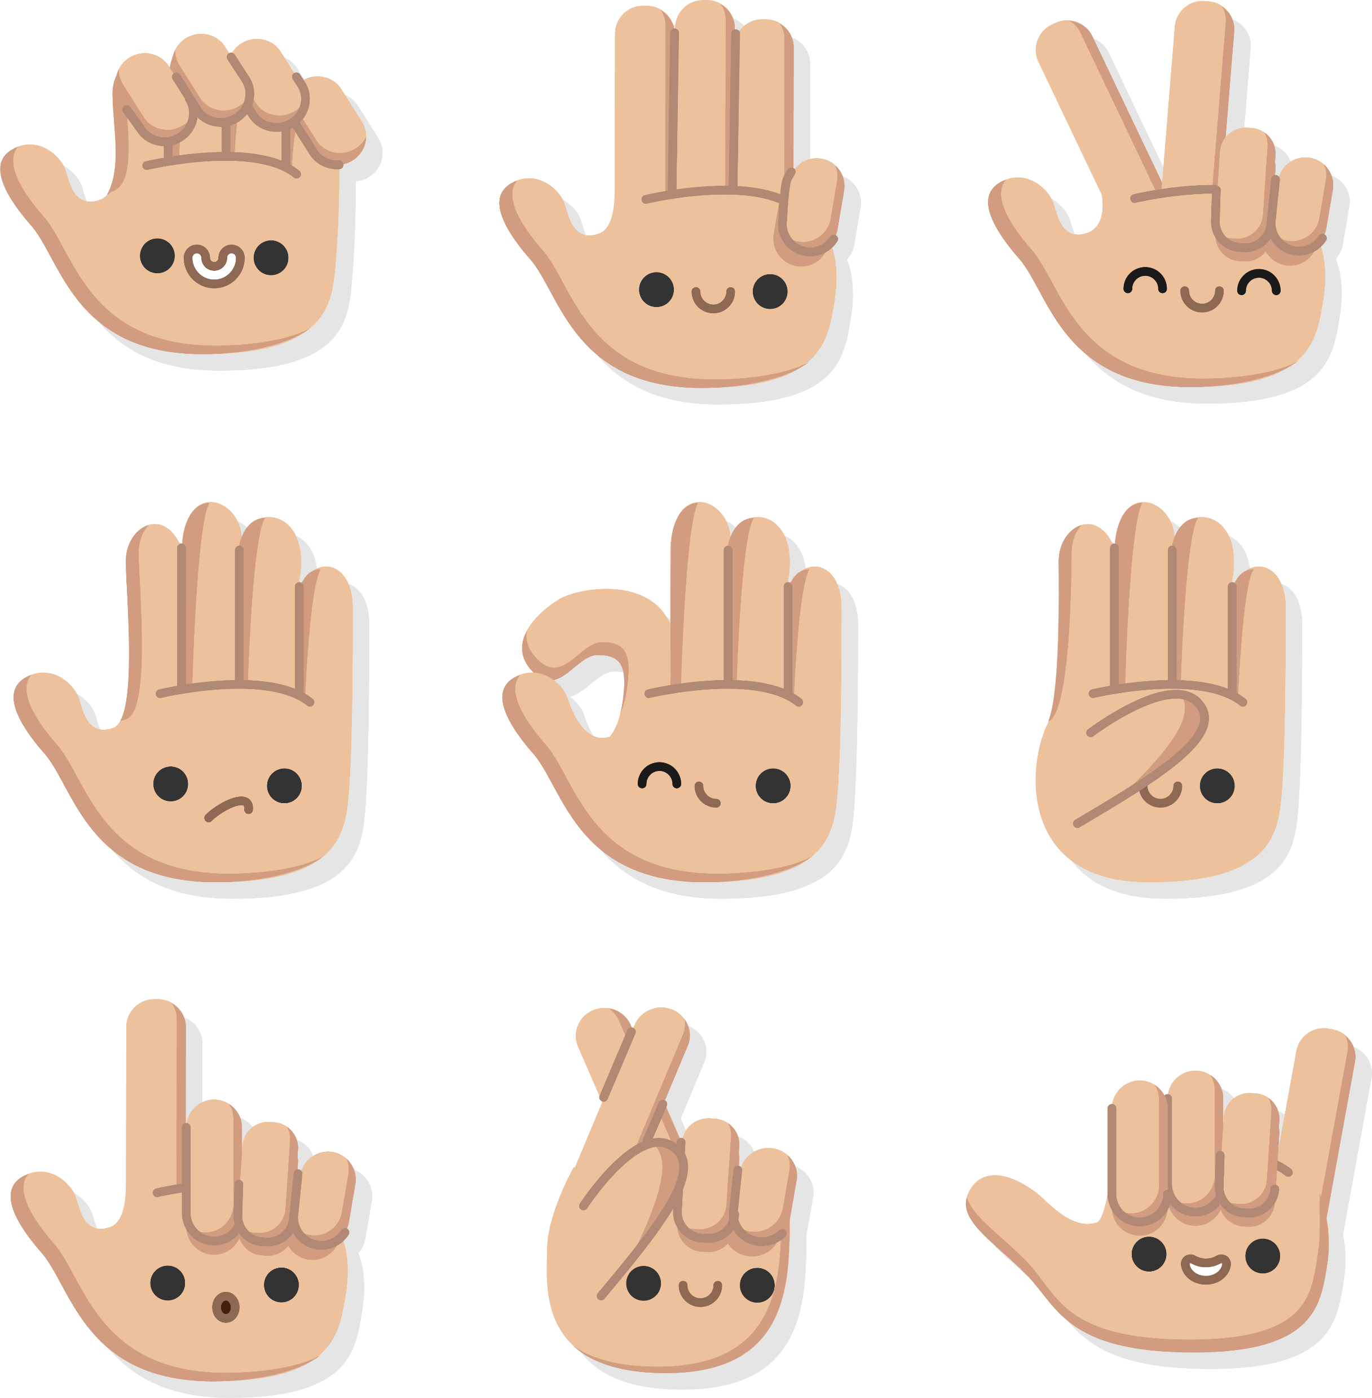
Sign language

Slide 4
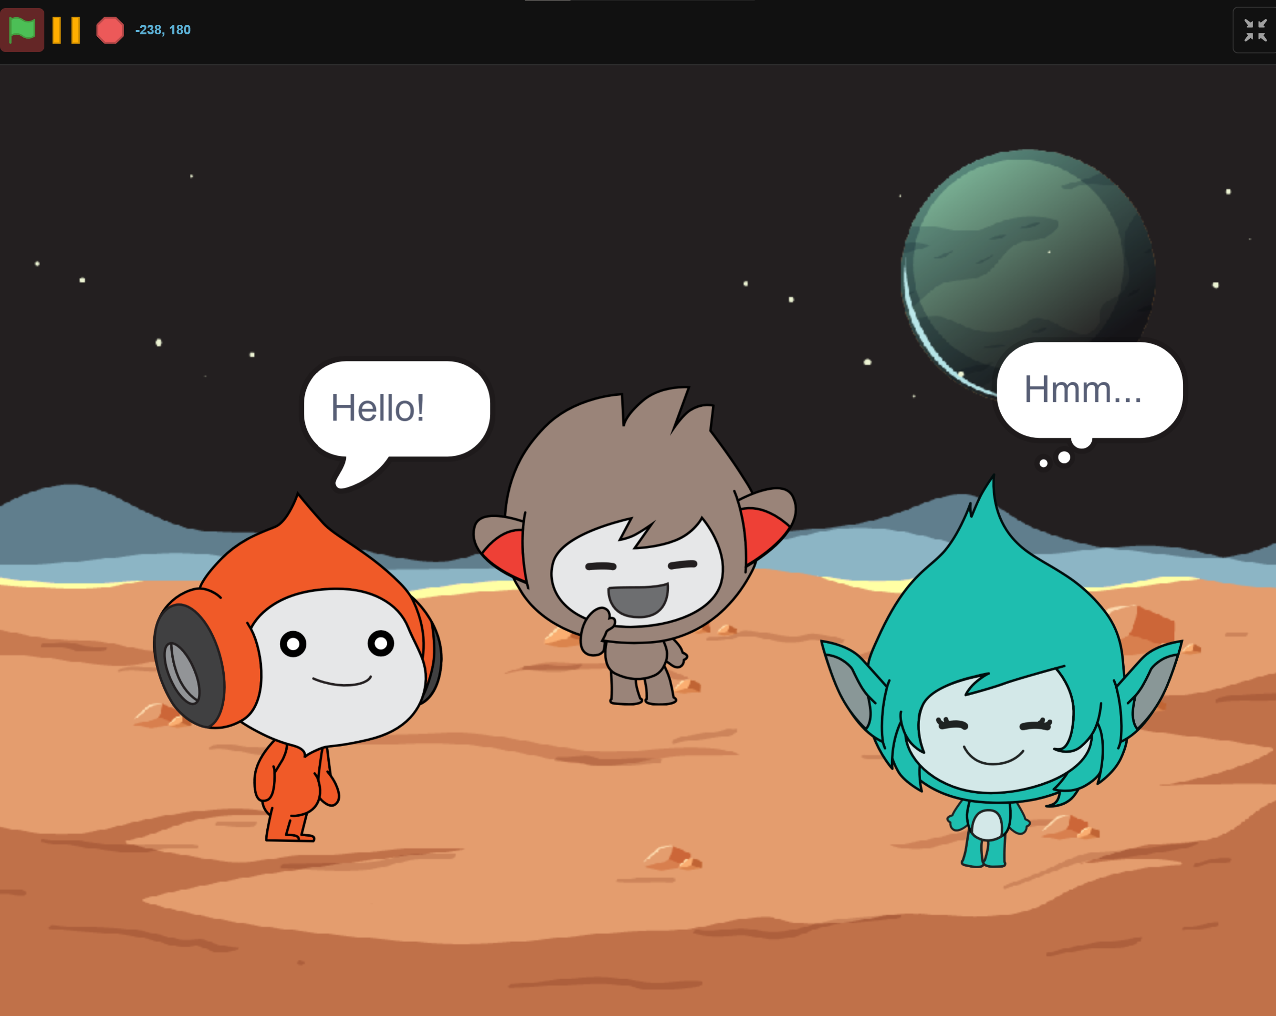
What we will Create…

Slide 5

Course FIles
Notes
Lesson 1
…
Resources
Level 1
Scratch for Newbies
Level 2
Lesson 6
Level 3

Slide 6
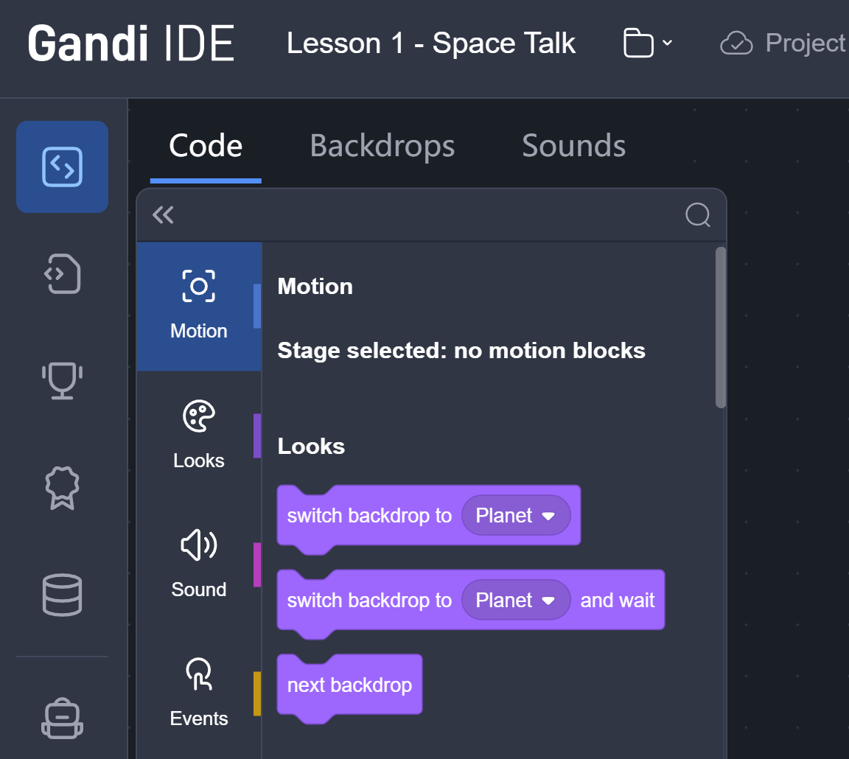
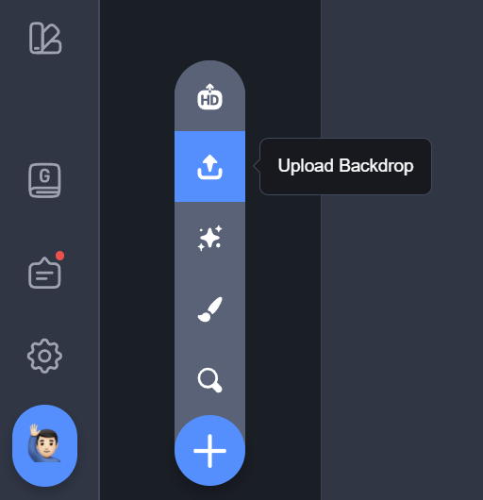
Upload backdrop

Slide 7
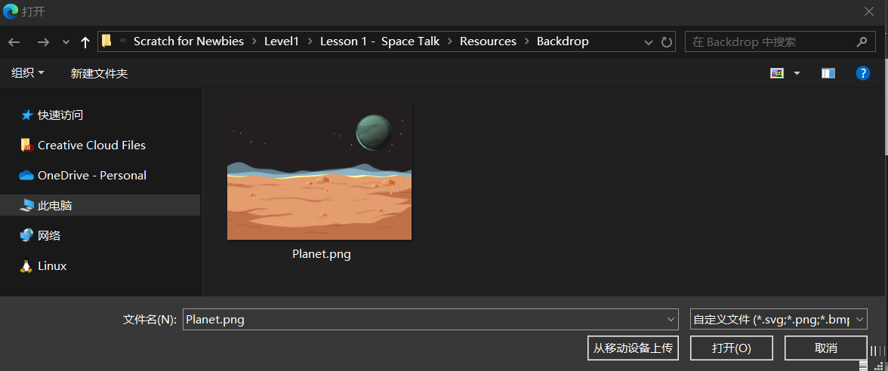
Upload backdrop
File Explorer

Slide 8
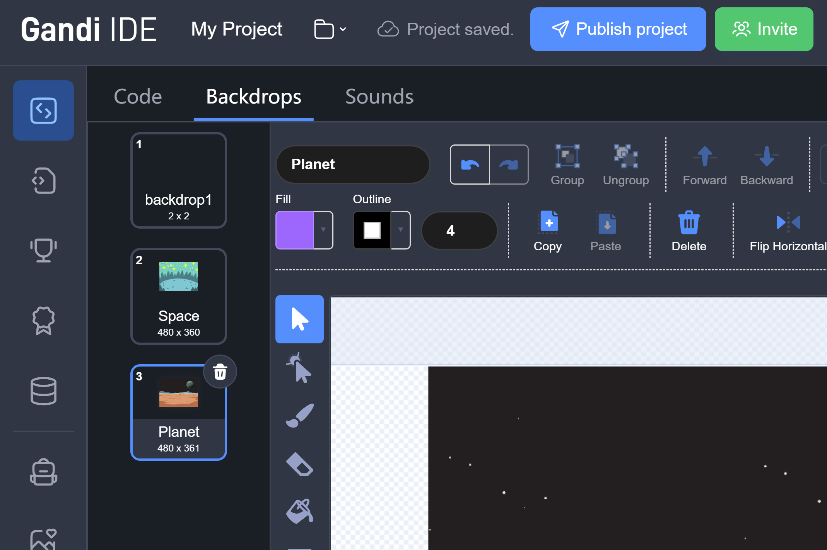
Upload backdrop

Slide 9
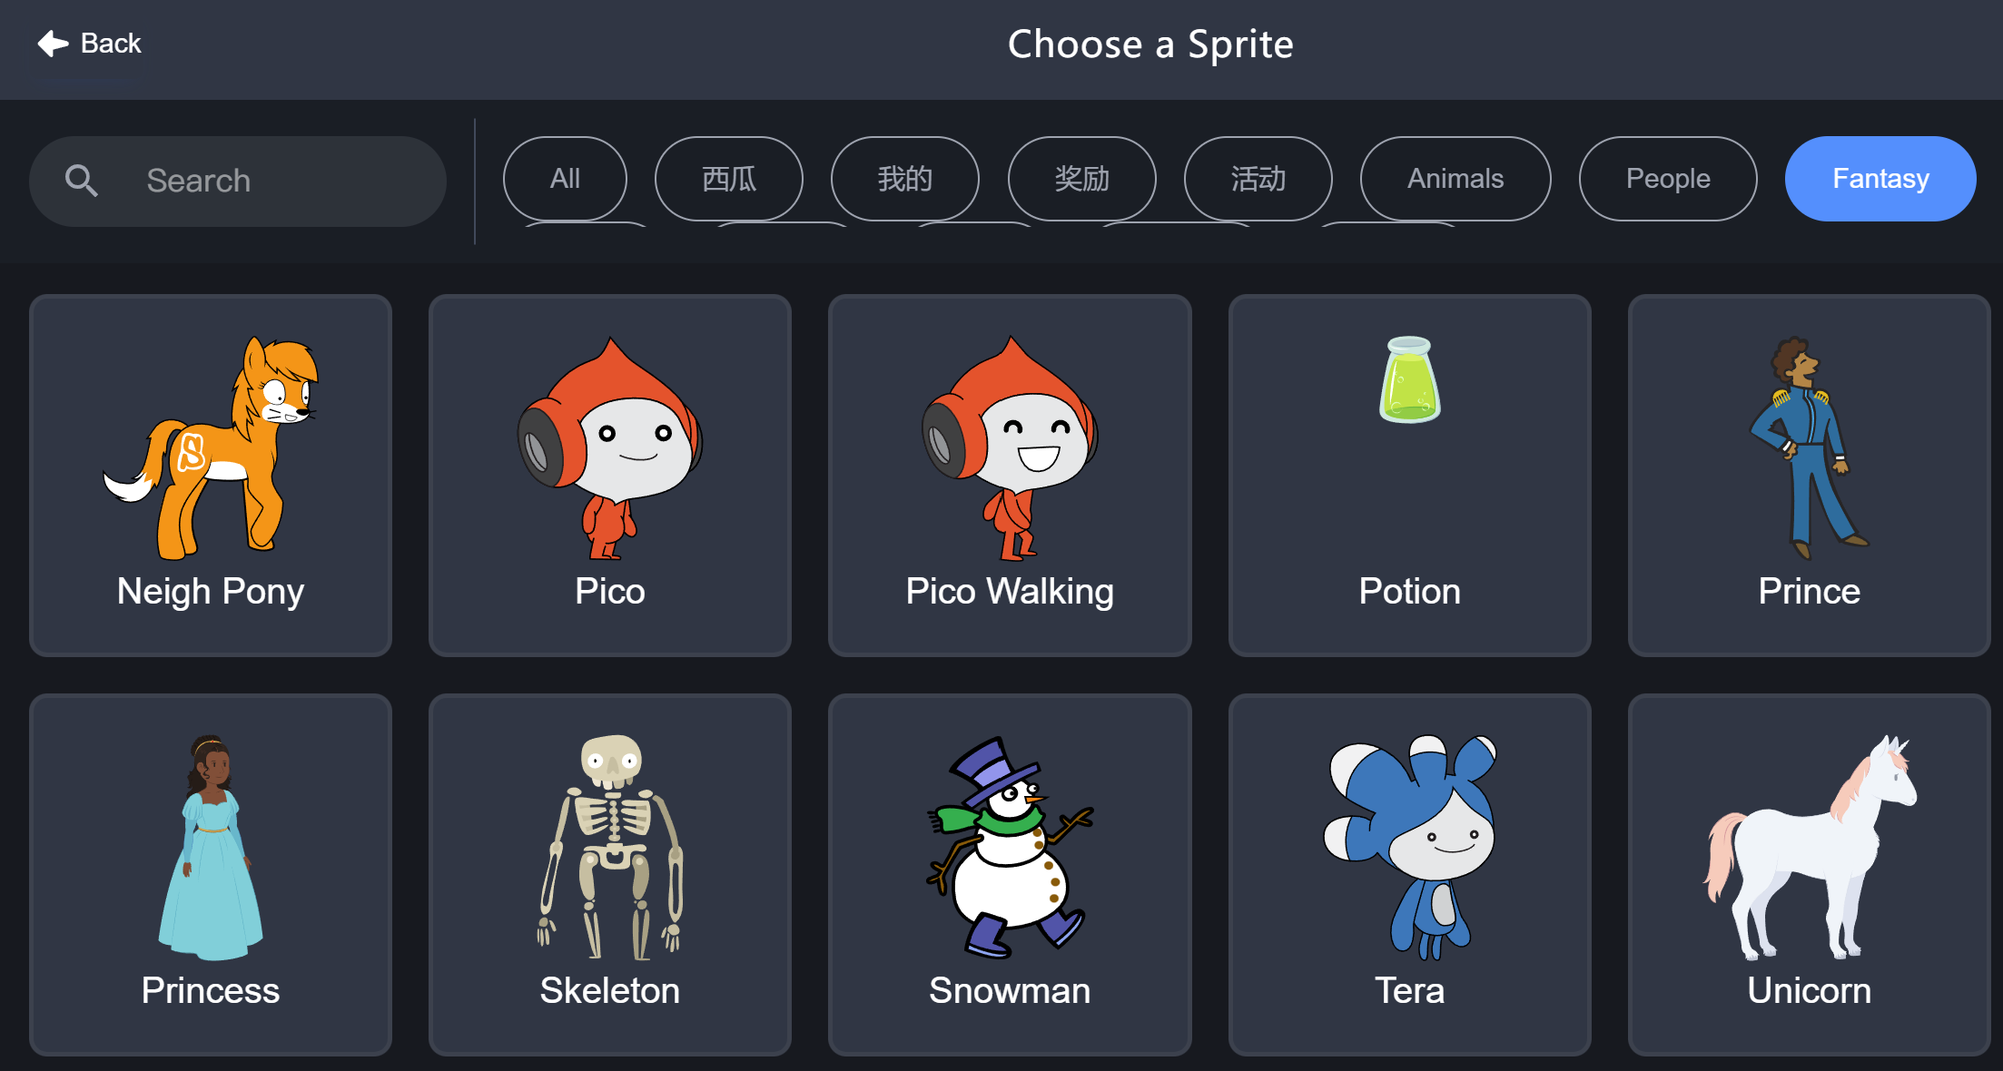
Pico

Slide 10


Pico says hello
2 seconds

Slide 11


Pico says hello

Slide 12


Pico says hello

Slide 13
Pico says hello

Slide 14
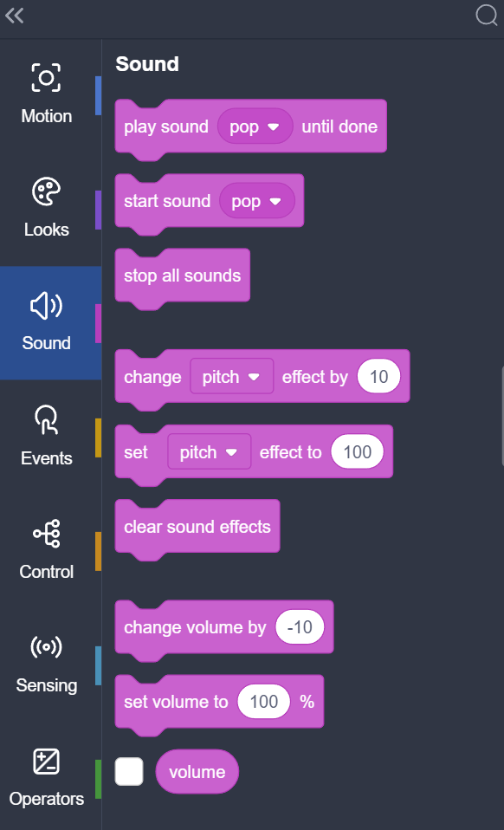
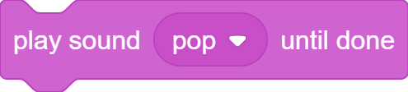

Pico Makes a sound

Slide 15
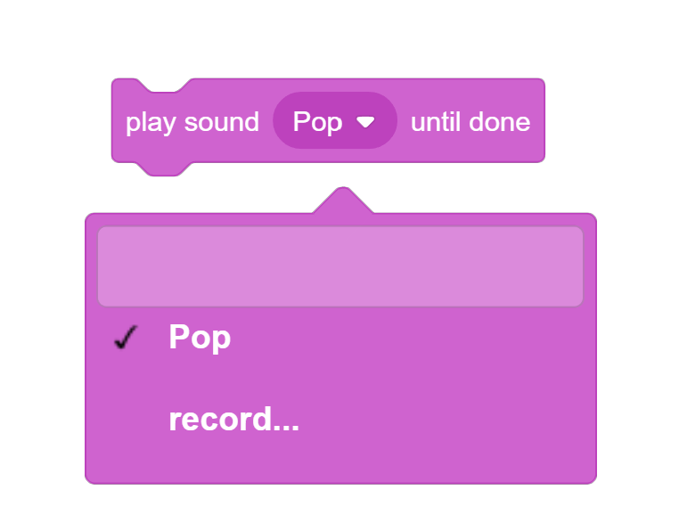

Pico Makes a sound

Slide 16
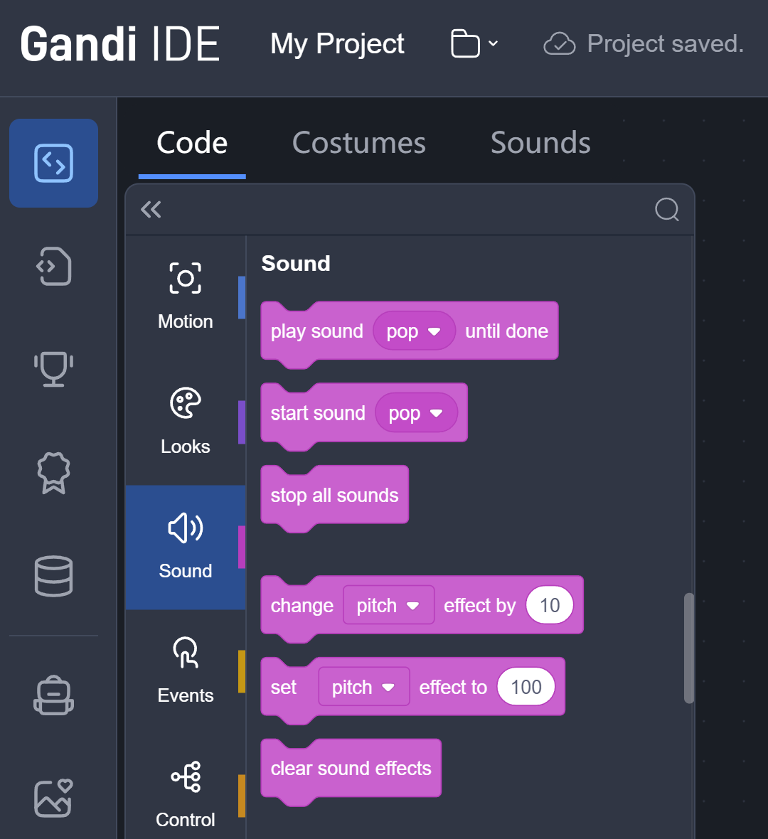
Pico Makes a sound

Slide 17
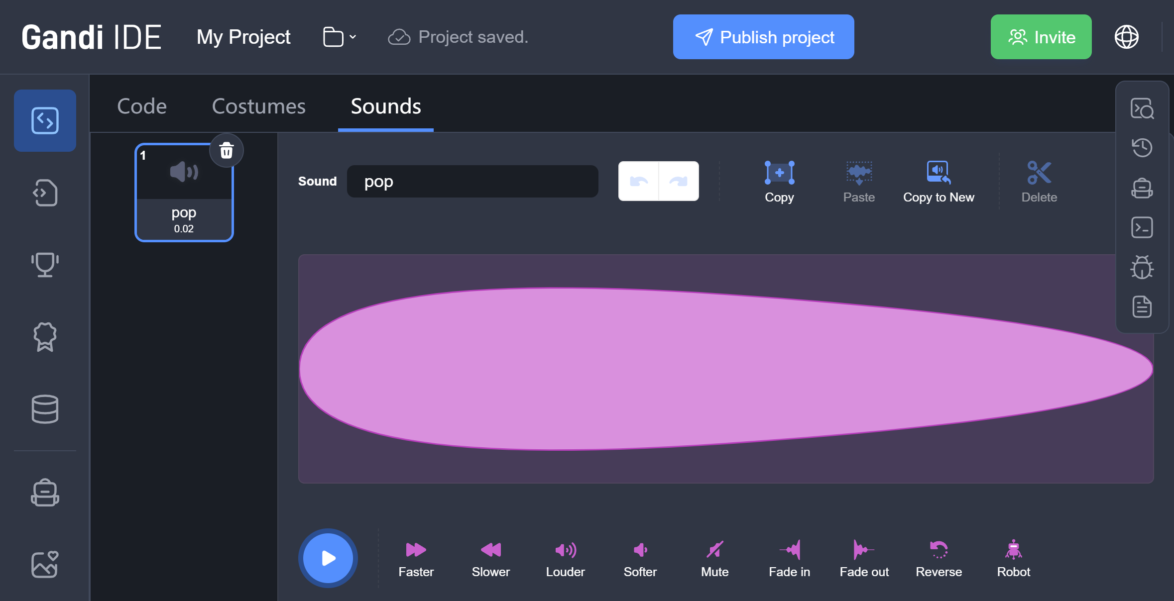
Pico Makes a sound

Slide 18
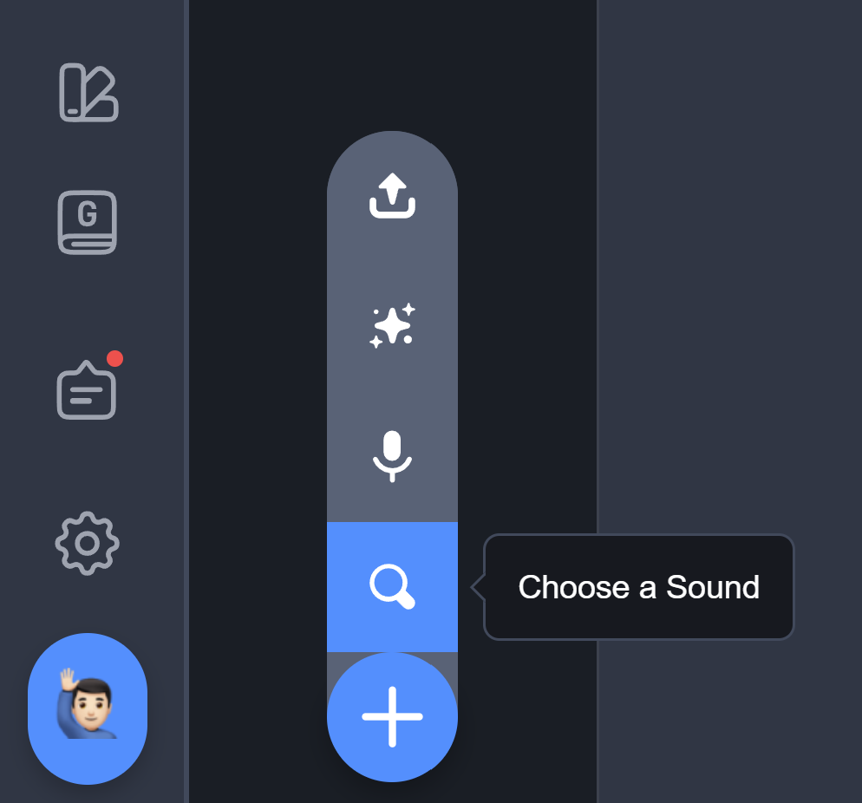
Pico Makes a sound

Slide 19
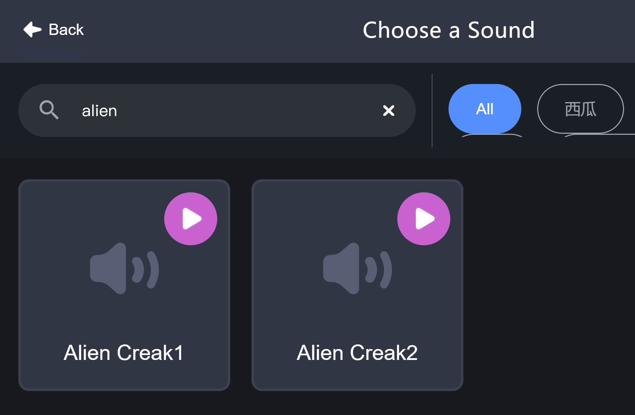
Pico Makes a sound

Slide 20
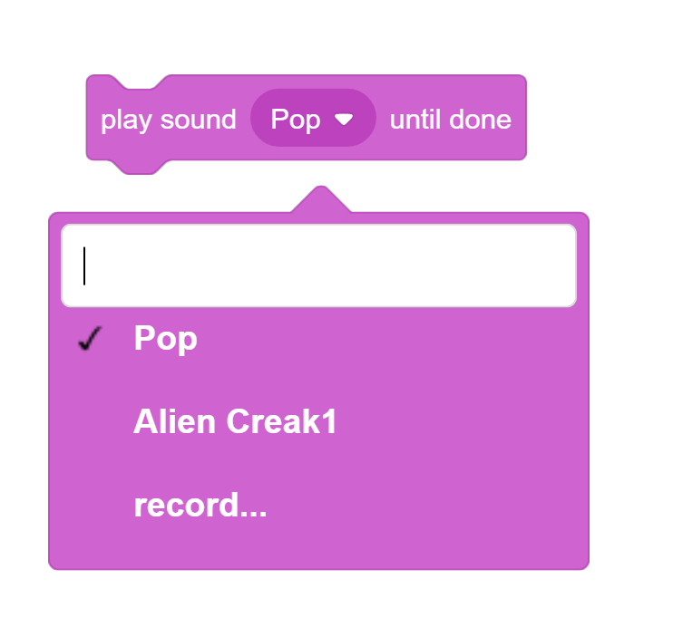
Pico Makes a sound

Slide 21
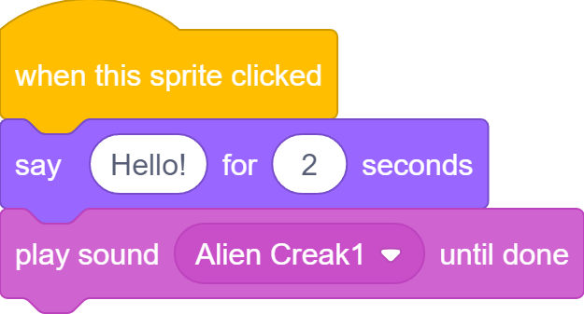
Pico Makes a sound

Slide 22
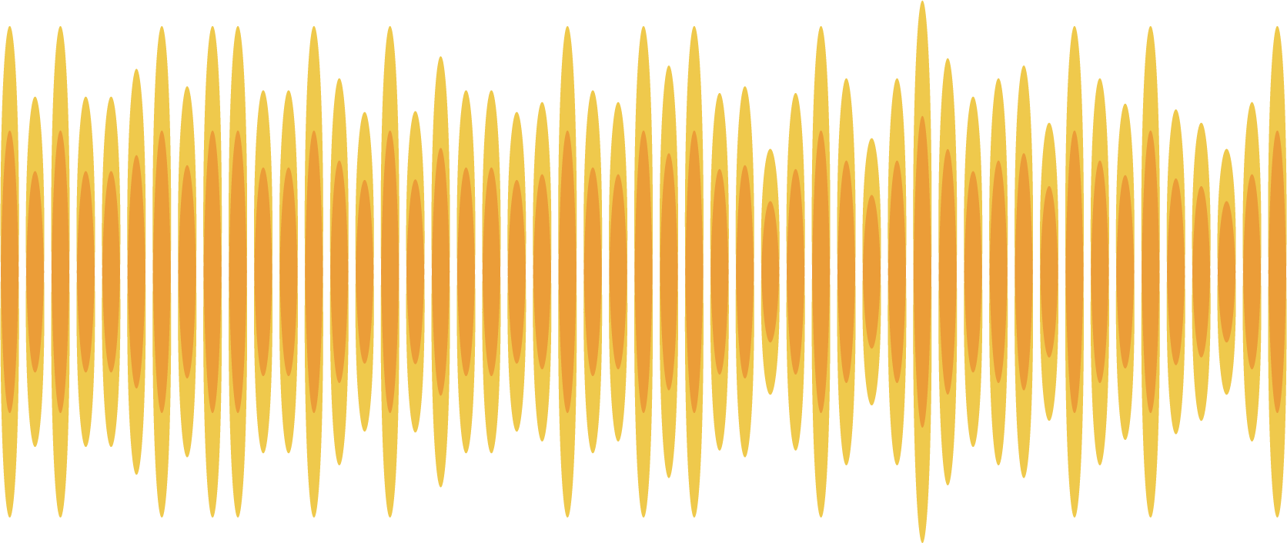
Pico Makes a sound
2 seconds

Slide 23
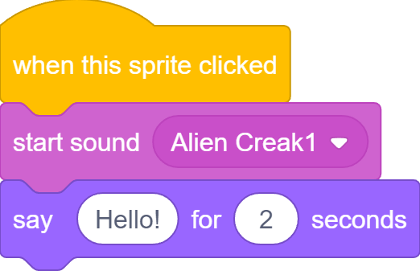
Pico Makes a sound

Slide 24
Pico Makes a sound

Slide 25
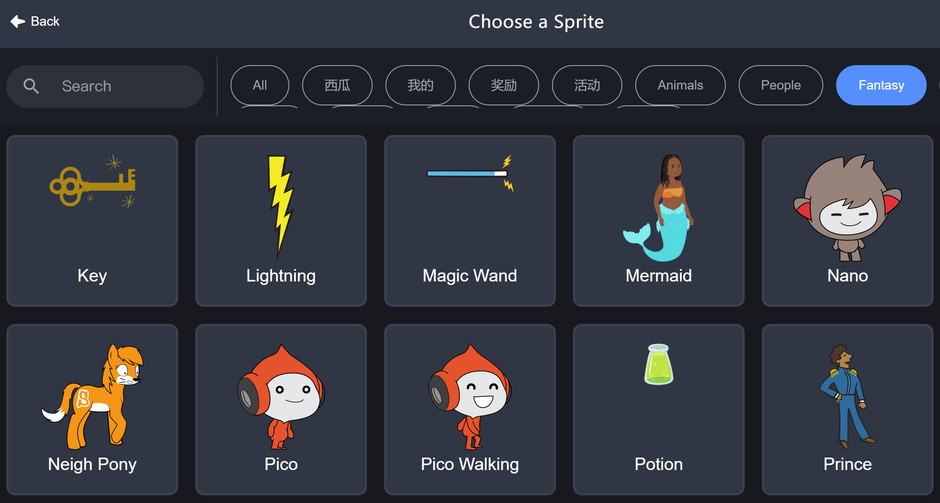
Nano

Slide 26
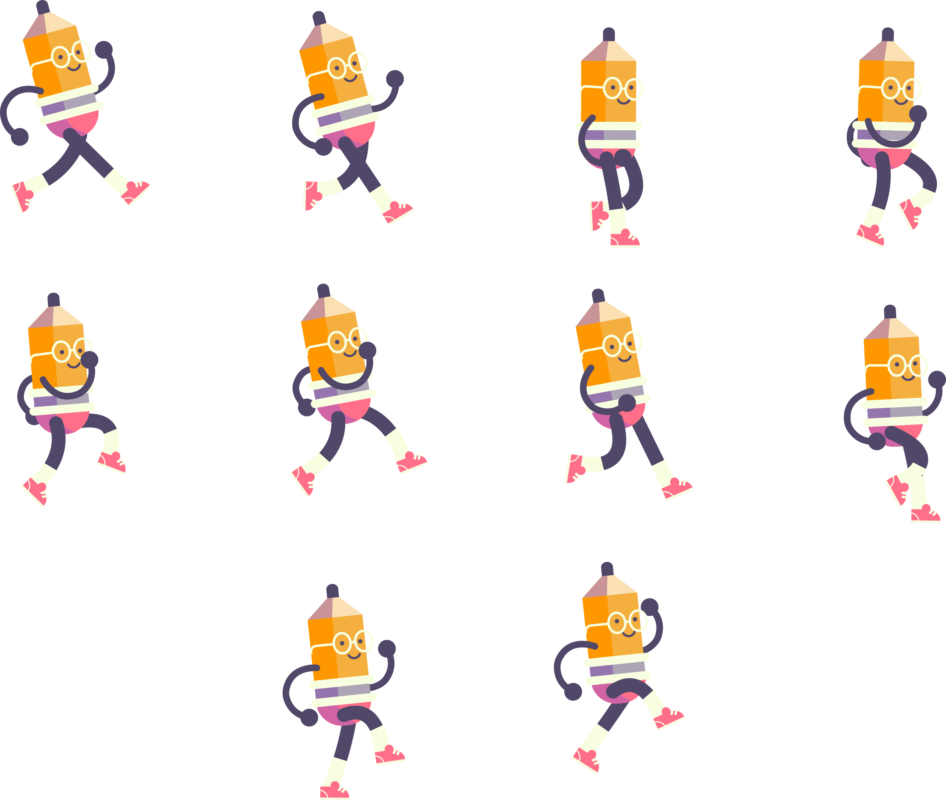

Flipbook animation

Slide 27
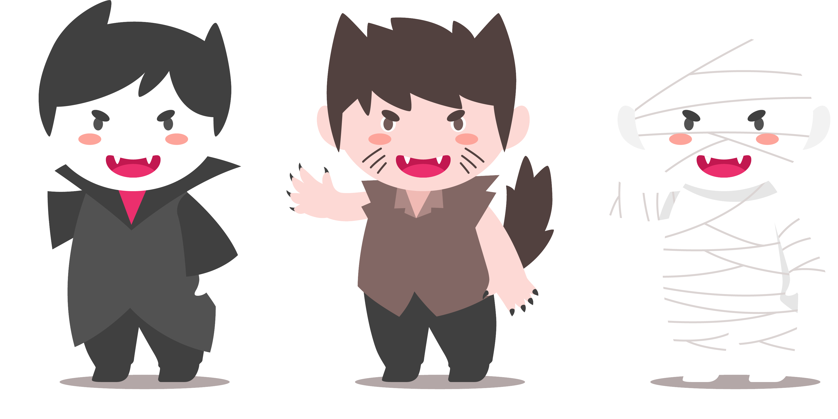
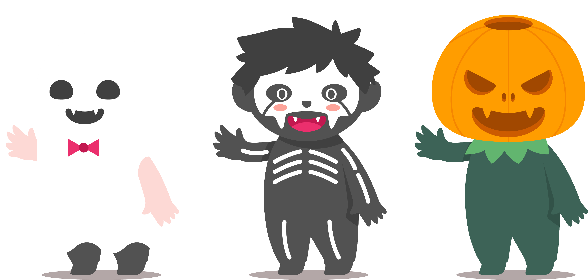
Costumes

Slide 28
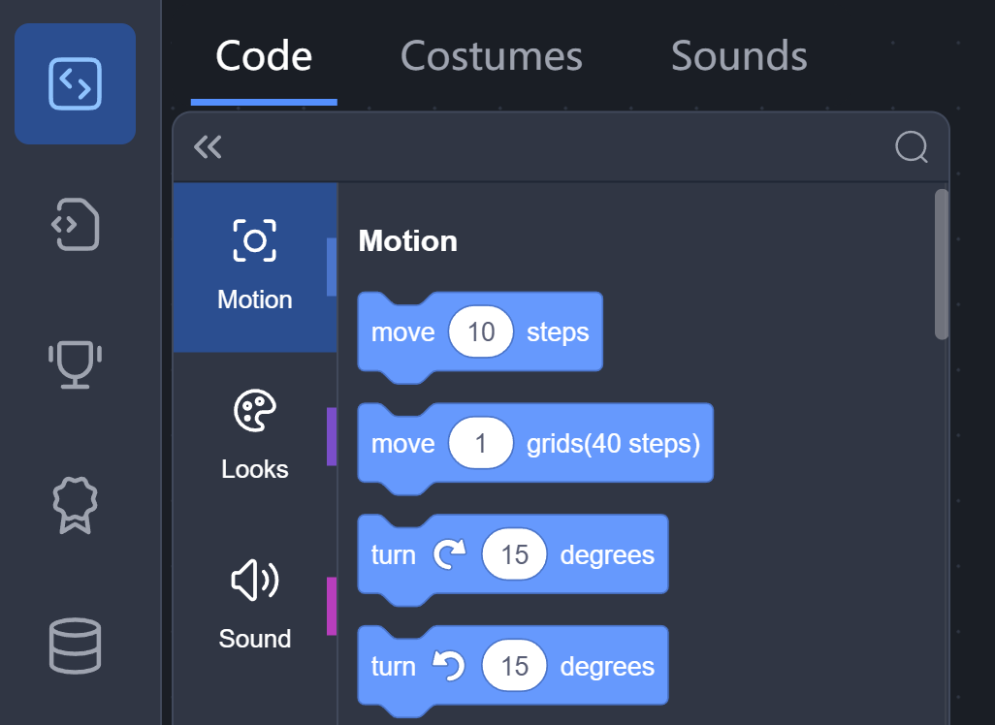
Costumes

Slide 29
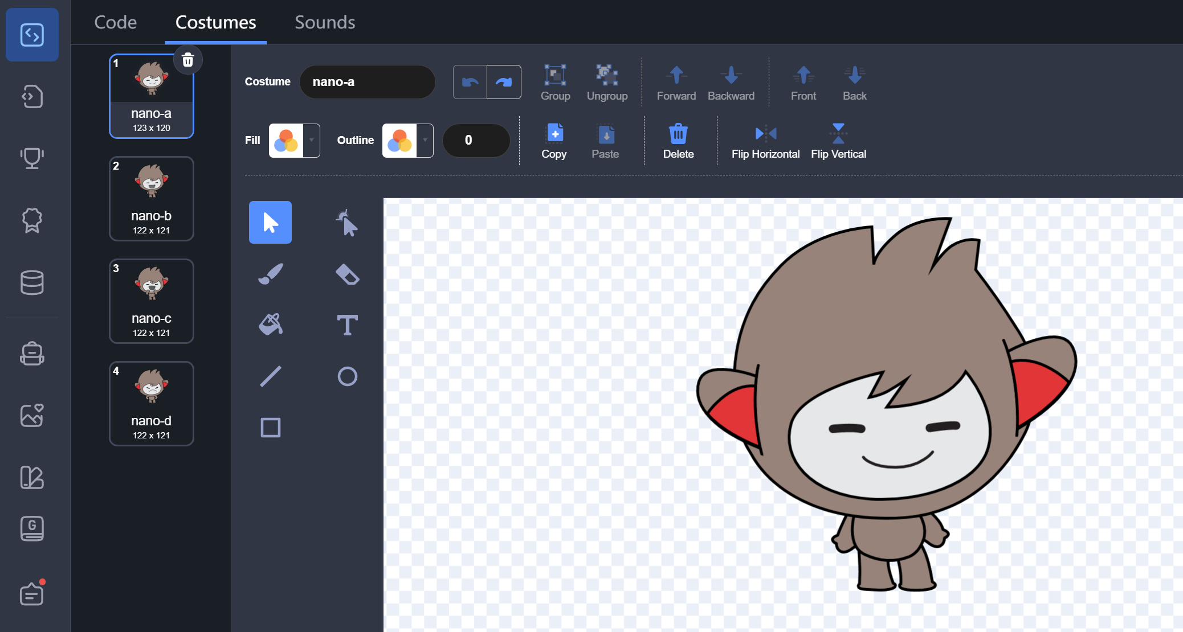
Costumes editor

Slide 30
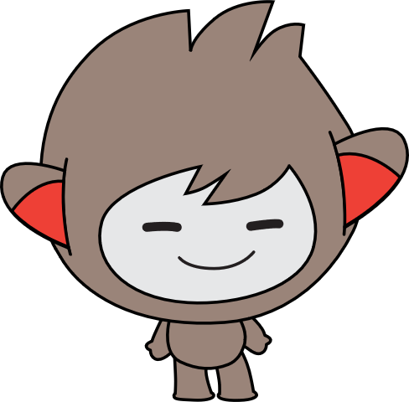
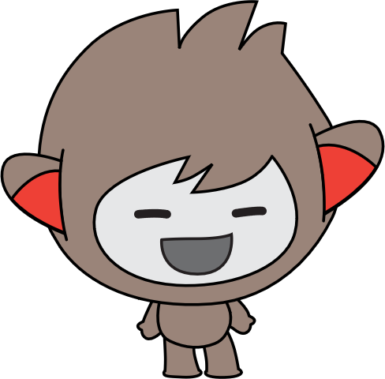
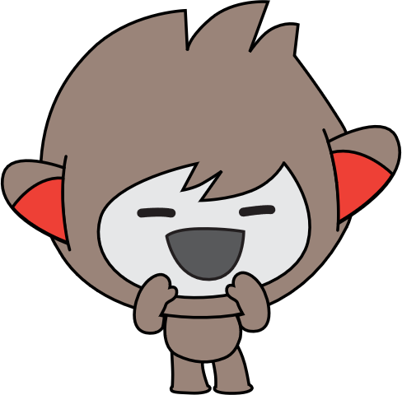
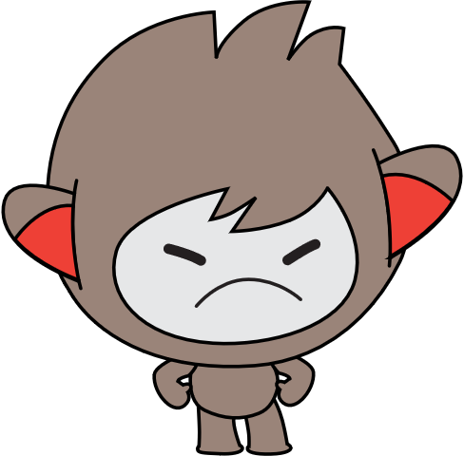
Nano’s costumes
nano-a
nano-b
nano-c
nano-d

Slide 31
Nano says “Thank you”
nano-a
nano-c

Slide 32
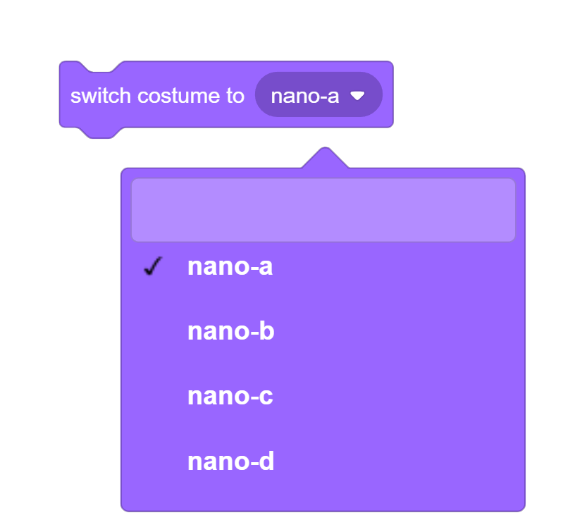
Switch costume

Slide 33
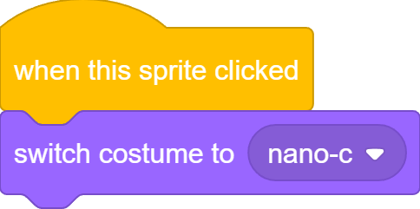
Switch costume

Slide 34
Switch costume
nano-a
nano-c

Slide 35
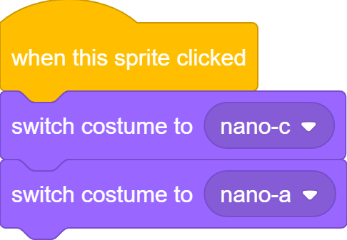
Switch costume

Slide 36
Switch costume
nano-a
nano-c
nano-a

Slide 37
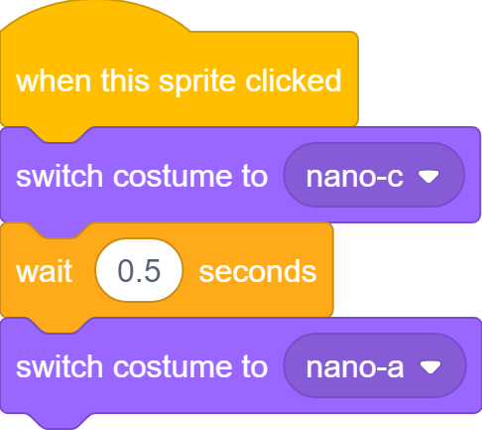
Switch costume

Slide 38

Switch costume
nano-a
nano-c
nano-a

Slide 39
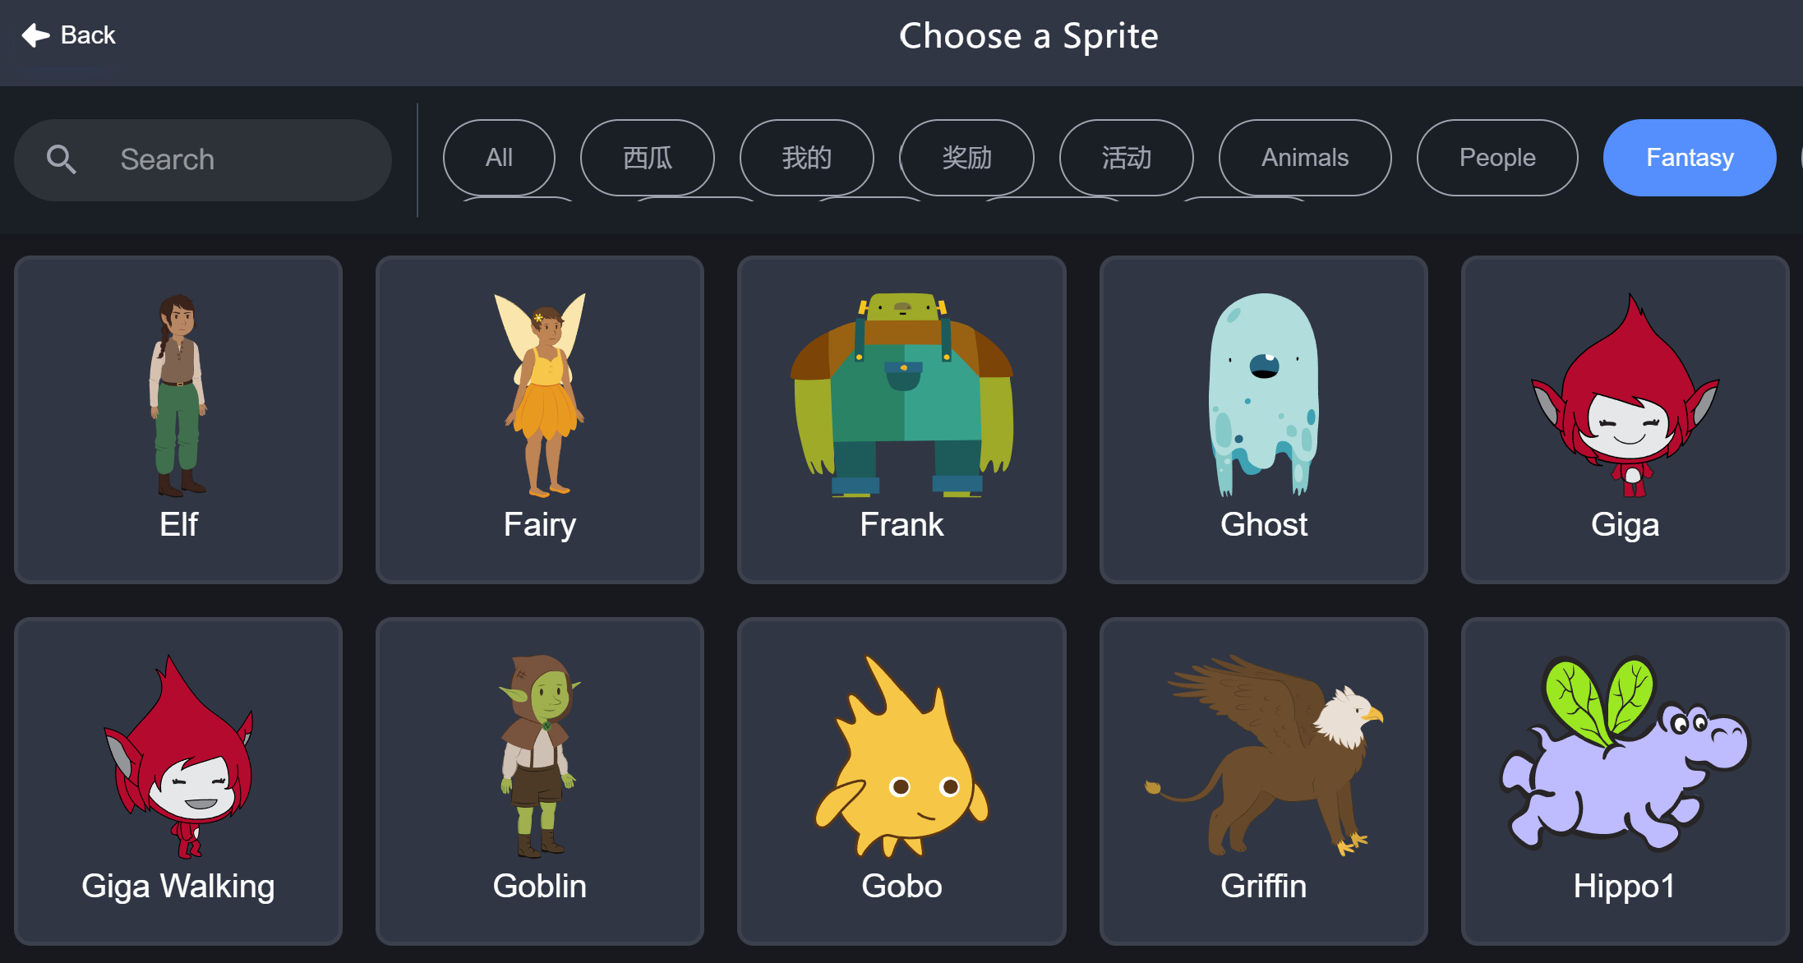
Giga

Slide 40


Giga Thinks

Slide 41

Giga thinks hmm…
2 seconds

Slide 42
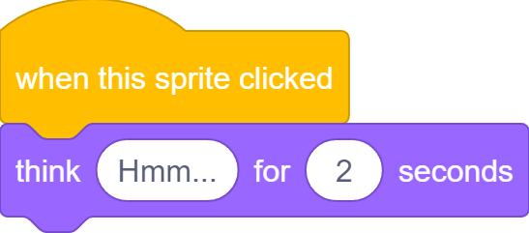
Giga thinks hmm…

Slide 43
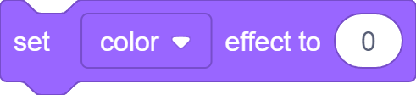
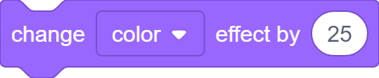
Giga changes color

Slide 44
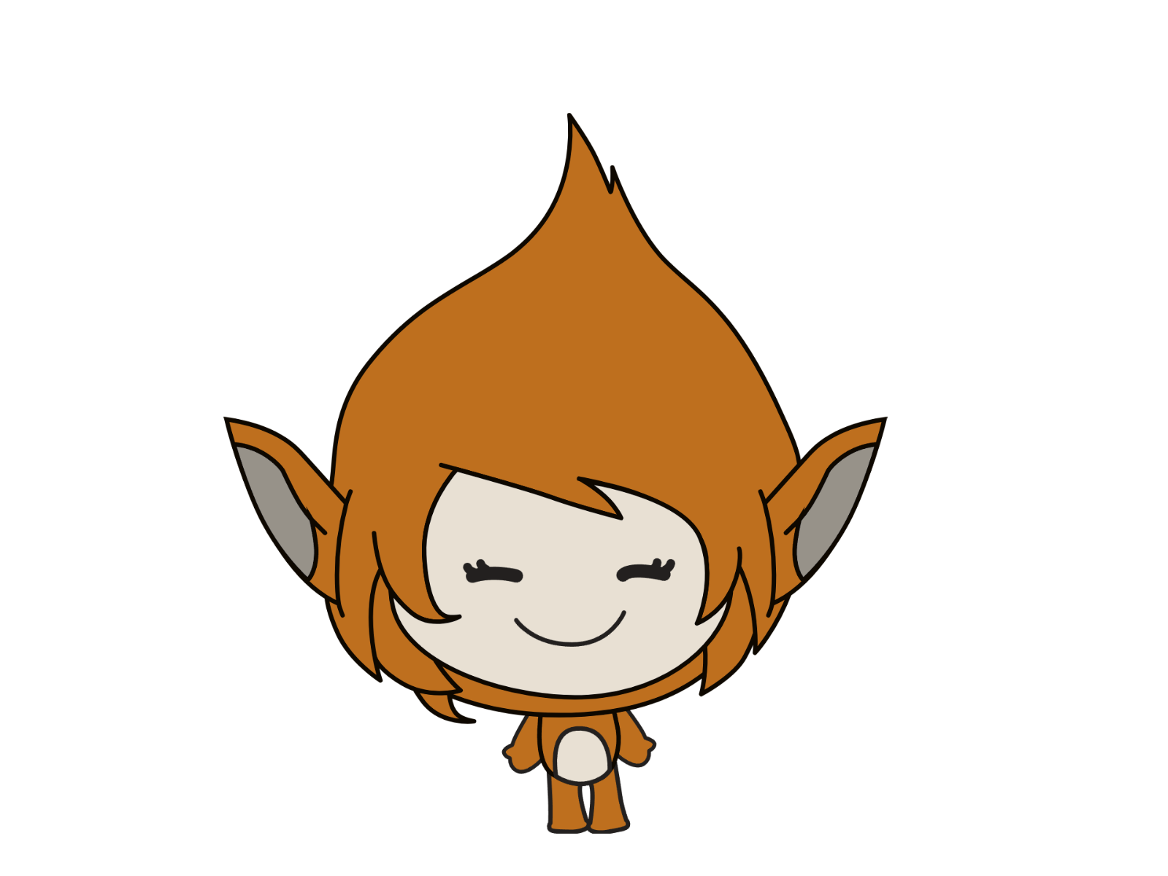
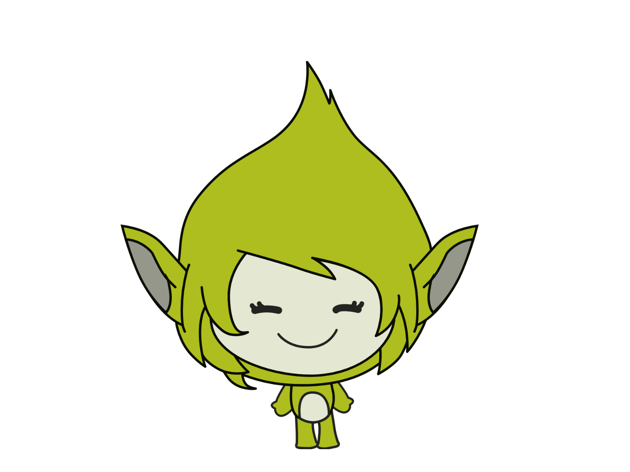
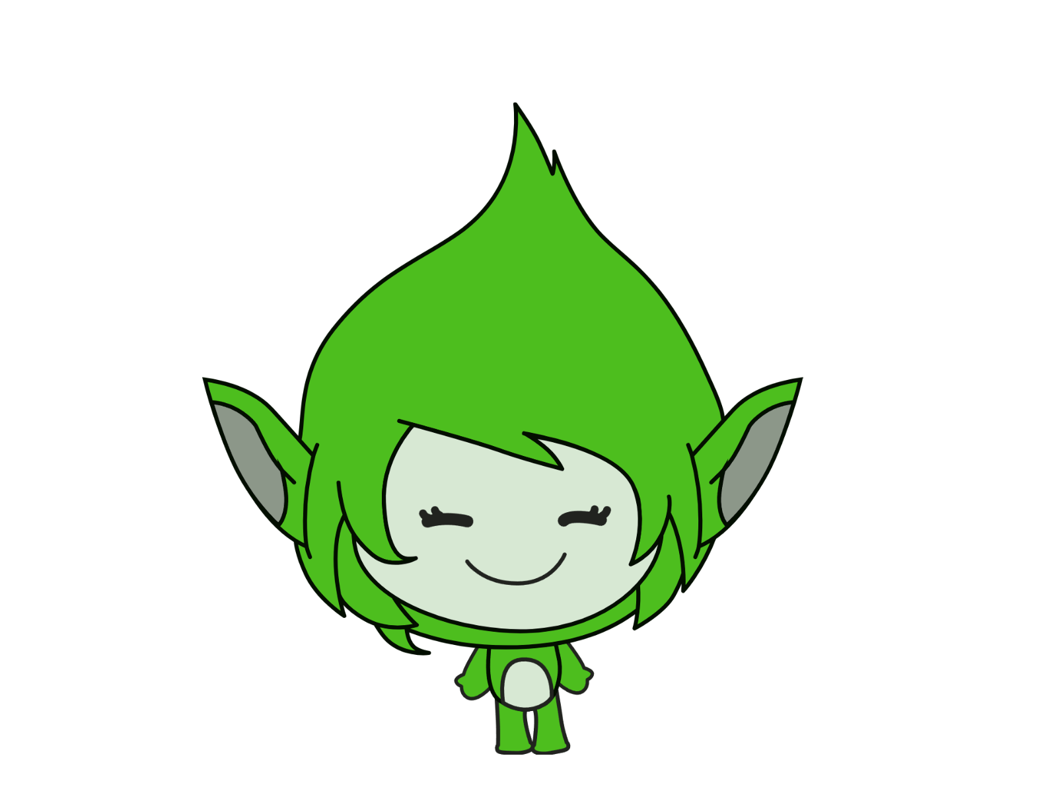

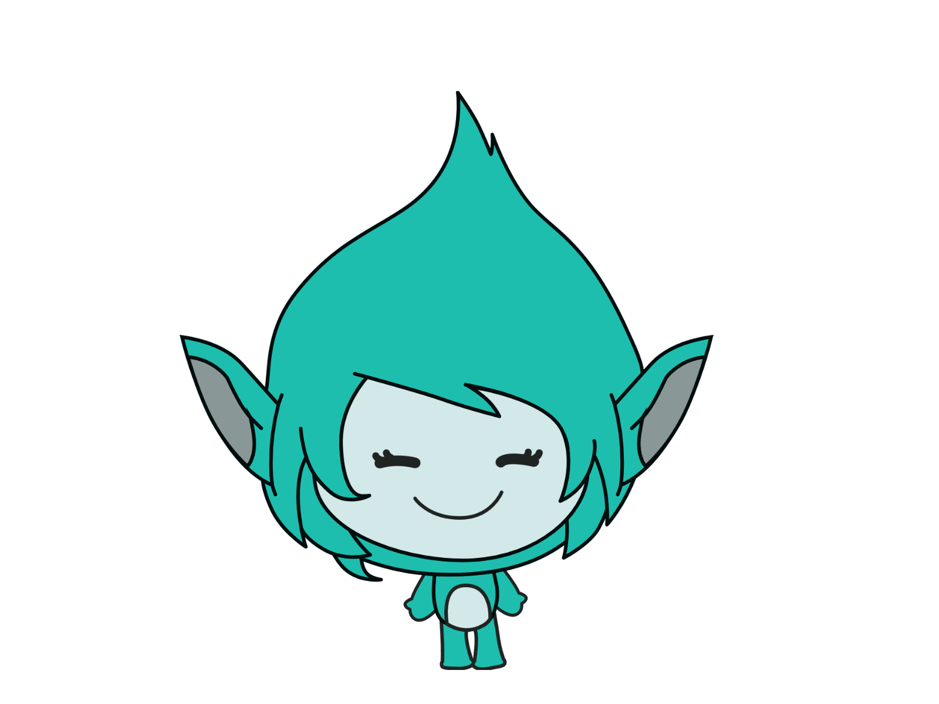
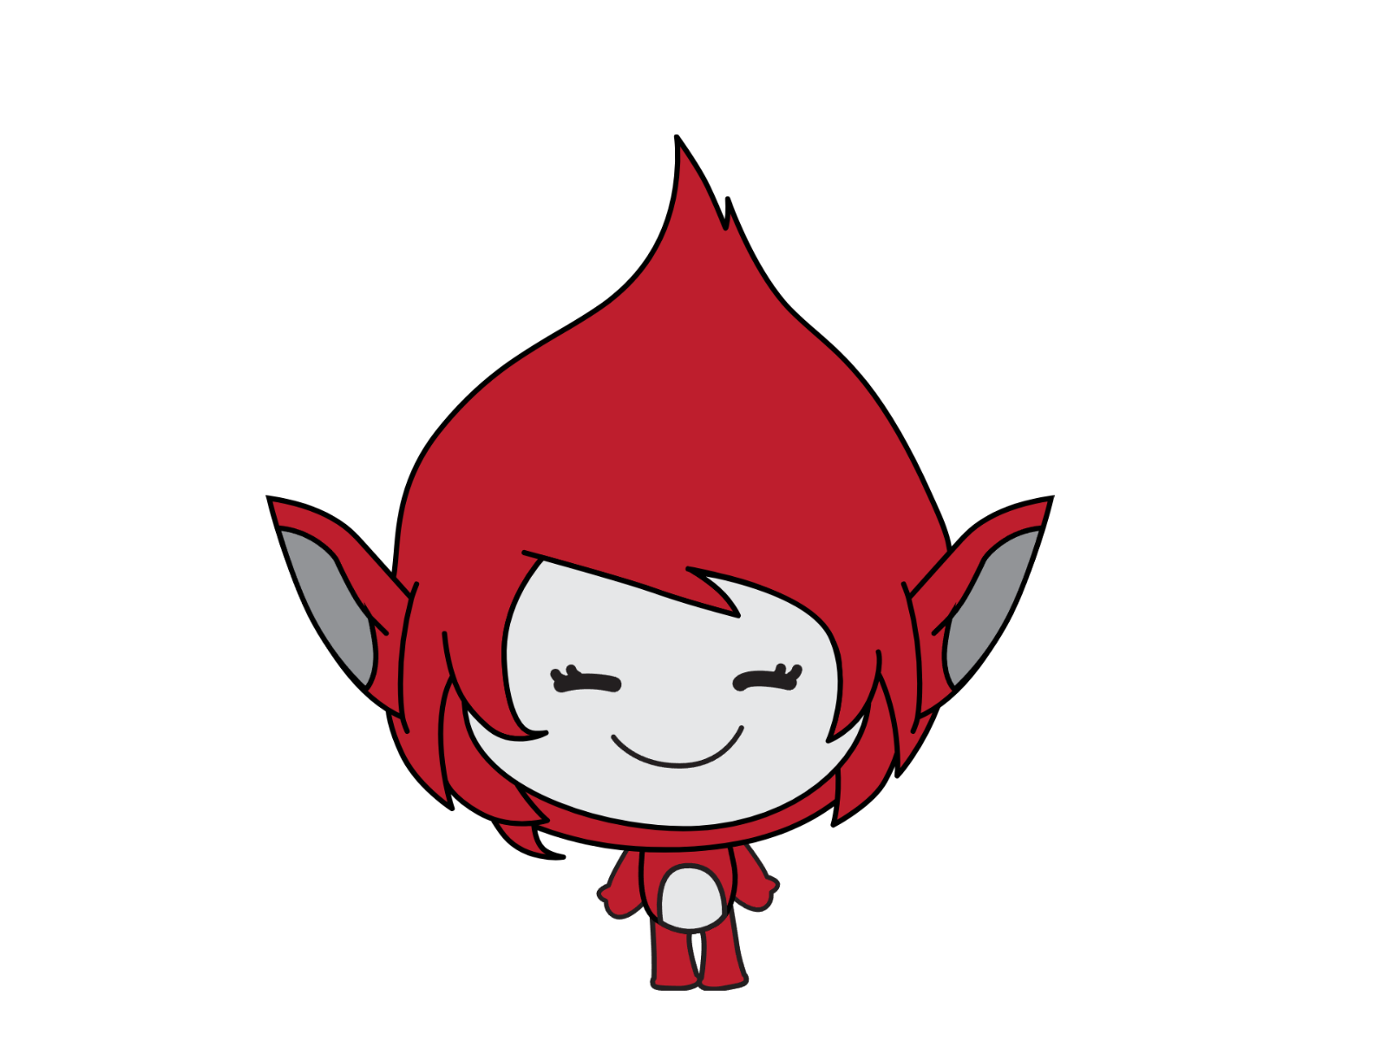
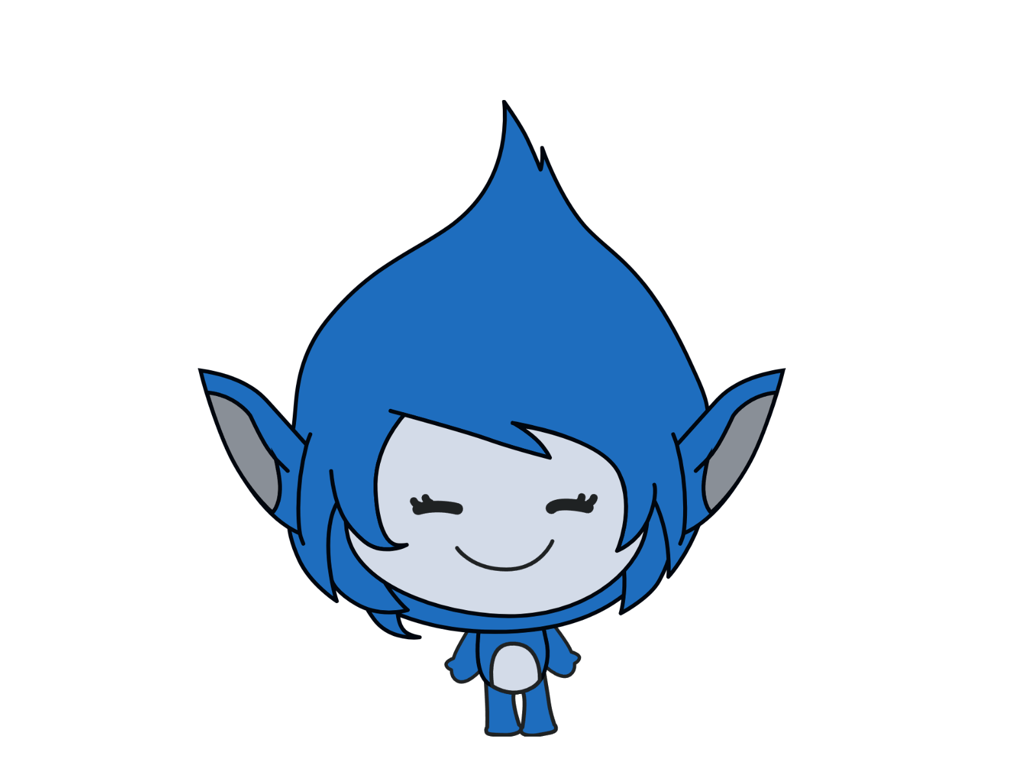
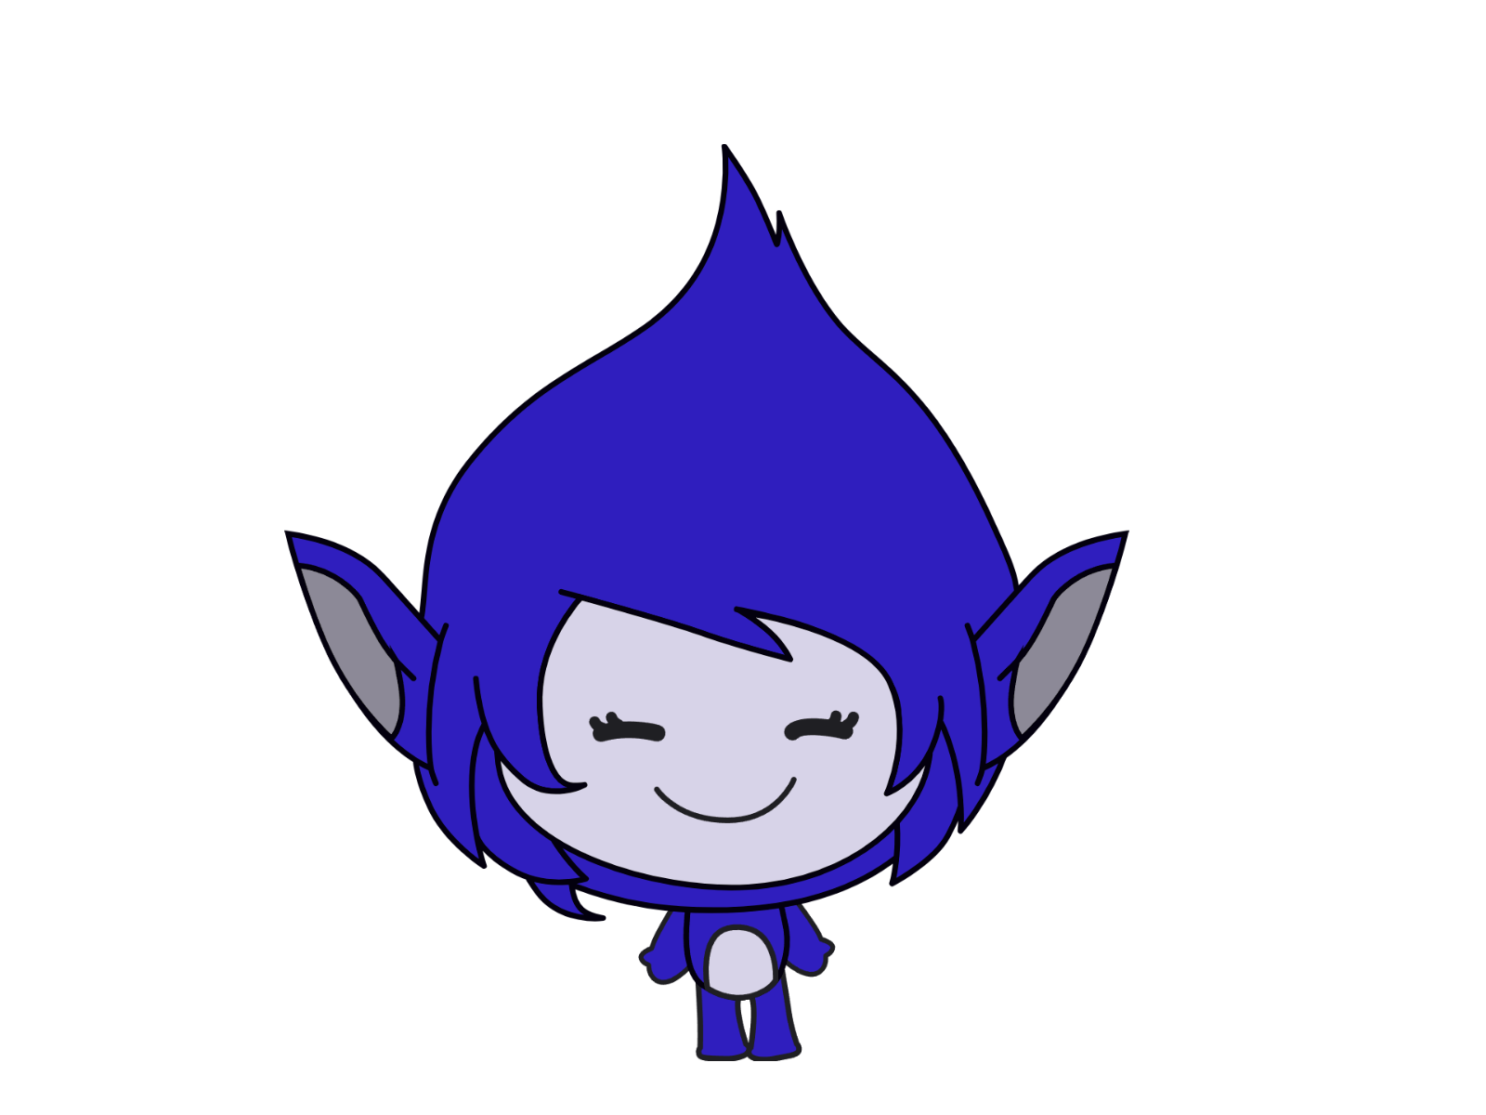
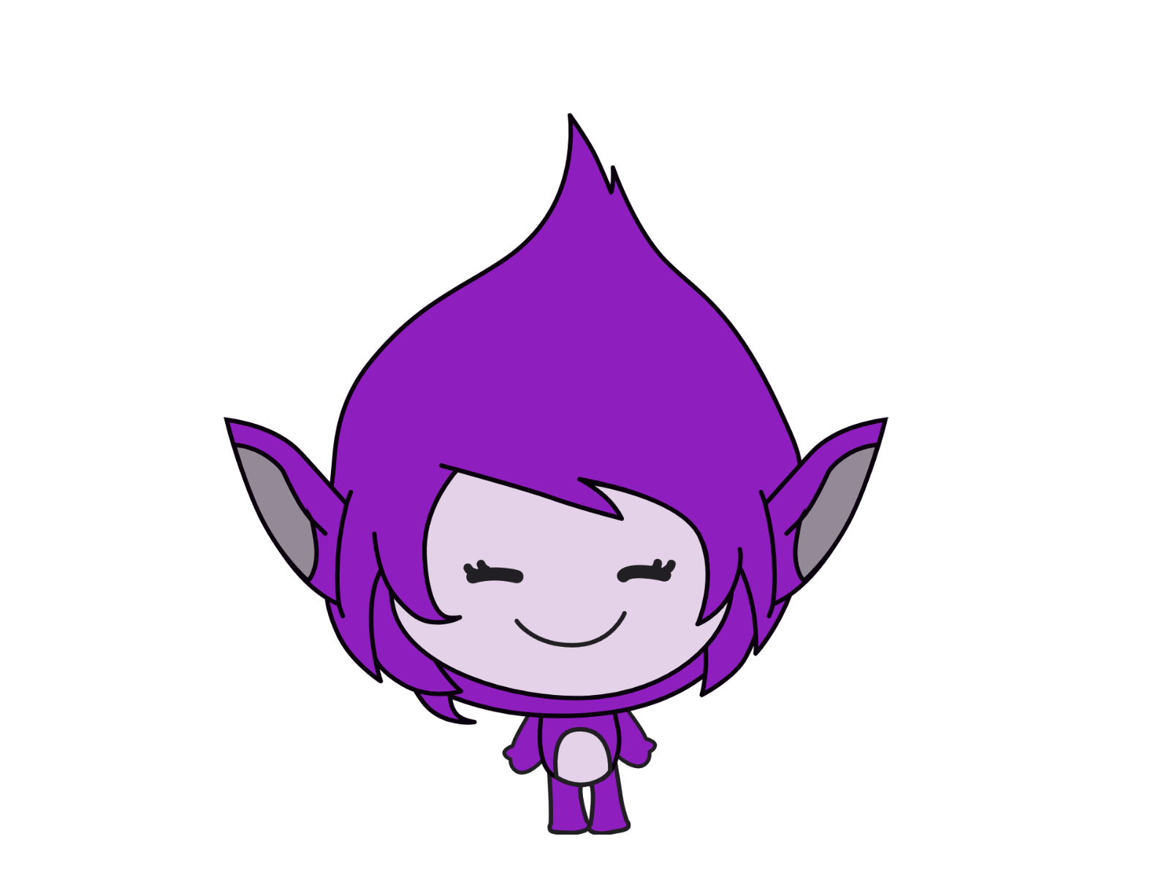

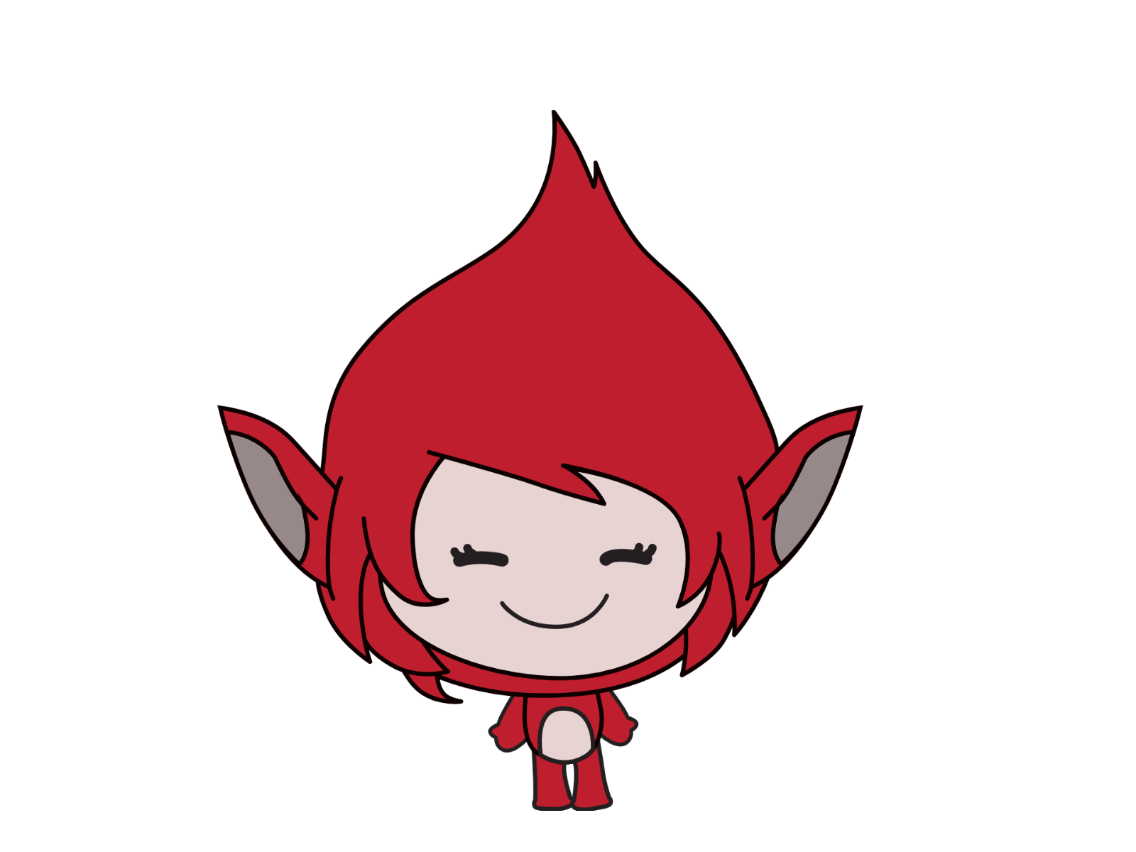
Color Values
20
40
60
80
100
0
120
140
160
180
200

Slide 45

Giga changes color

Slide 46
Giga changes color
2 seconds

Slide 47

Giga changes color

Slide 48
Giga changes color

Slide 49

reset color

Slide 50
reset color

Slide 51

reset color

Slide 52

reset color

Slide 53
What we learnt…
Sprites can say or think…

Slide 54
What we learnt…
Sprites can make some noise…

Slide 55

What we learnt…
Sprites can change costumes…

Slide 56
What we learnt…
Sprites can change colors…

Slide 57


What we learnt…
Sprites can wait…

Slide 58
What we learnt…
Sprites can respond to click…

Slide 59
Exercises
Have fun with some of the other effects
Try different sprites and backdrops
Say and think differently
Checkout costumes of other sprites
Invent your own way of communication!

Slide 60
Thank you and see you in the next lesson!

